Slide 1


Chapter 2
Understanding Hypervisors
Virtualization Essentials

Slide 2
Chapter 2 Objectives
Describe a hypervisor
Understand the difference between Type 1 and Type 2 hypervisors
Understand the two roles of a hypervisor
Understand the history of today’s hypervisors and the commercial market
2

Slide 3
What Is a Hypervisor?
Software that abstracts hardware resources from virtual machine
A hypervisor also manages all of the interactions between a virtual machine and the hardware resources
Also known as a virtual machine manager (VMM)
Can run directly on hardware or as an application on an operating system
Not a new concept but recent in widespread commercial use
3

Slide 4
Type 1 Hypervisor
Runs directly on the hardware
More secure and more available
Offers better performance to the guests it supports
4

Slide 5
Type 2 Hypervisor
Runs on top of an operating system
Leverages the OS drivers
Often used for desktop development and testing
5

Slide 6
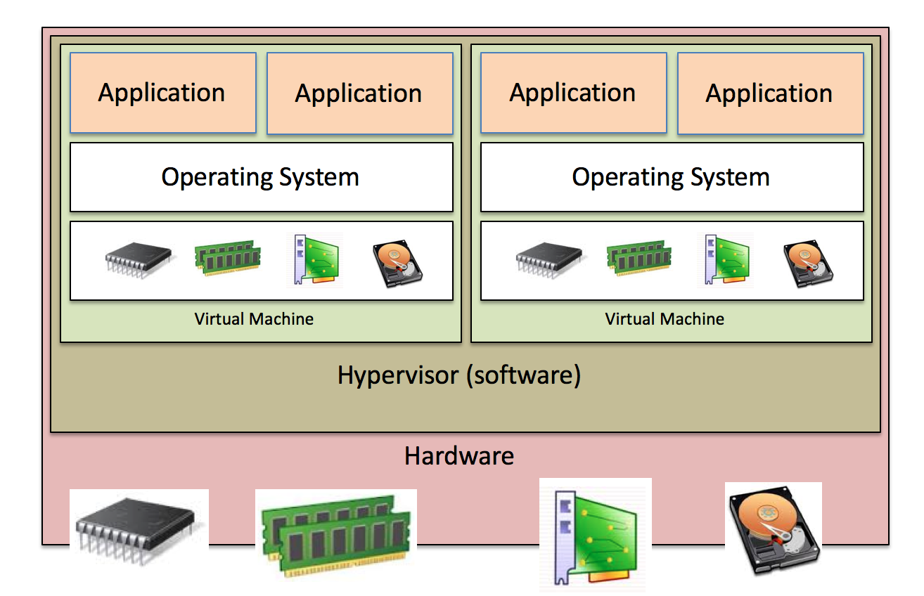
Abstracting Hardware
Guests “see” virtual resources
Hypervisors present guests with only a fraction of the host’s available physical resources
Hypervisors manage the resource I/O and load balance the aggregate workload fairly
6

Slide 7
VMware ESXi
First commercially available hypervisor (1998) for the x86 platform
Currently market leader in user share and maturity of offerings
Architecture not tied to an operating system
7

Slide 8
Xen
Began as a Cambridge University research project
First released in 2002 as an open source project
Currently exists as an open source project and the core has been used by a number of vendors including Citrix and Oracle
Dom0 is primarily based on Linux
8

Slide 9
Microsoft Hyper-V
First release in 2008, but virtualization was available through Virtual Server in 2005
Similar architecture to Xen; device drivers part of the parent partition
Parent partition is based on Microsoft Windows
9

Slide 10
Other Solutions
Red Hat KVM
Initially XEN, now kernel based (KVM)
Oracle
Oracle VM is XEN based
Other solutions available with Sun acquisition
Cloud-based
Amazon and Google make extensive use of virtualization, but their technologies are usually hidden from the user
Many other commercial and free solutions available, but the space is still evolving
10

Slide 11
Chapter 2 Summary
A hypervisor is software that allows multiple workloads to simultaneously run on the same hardware
Type 1 hypervisors run directly on server hardware, while Type 2 hypervisors run on an operating system
Hypervisors abstract the hardware resources from the VMs they support and load balance the utilization of those resources
Virtualization is still a new and growing space; market leaders include VMware, Microsoft, and Citrix
11

